Slide 1
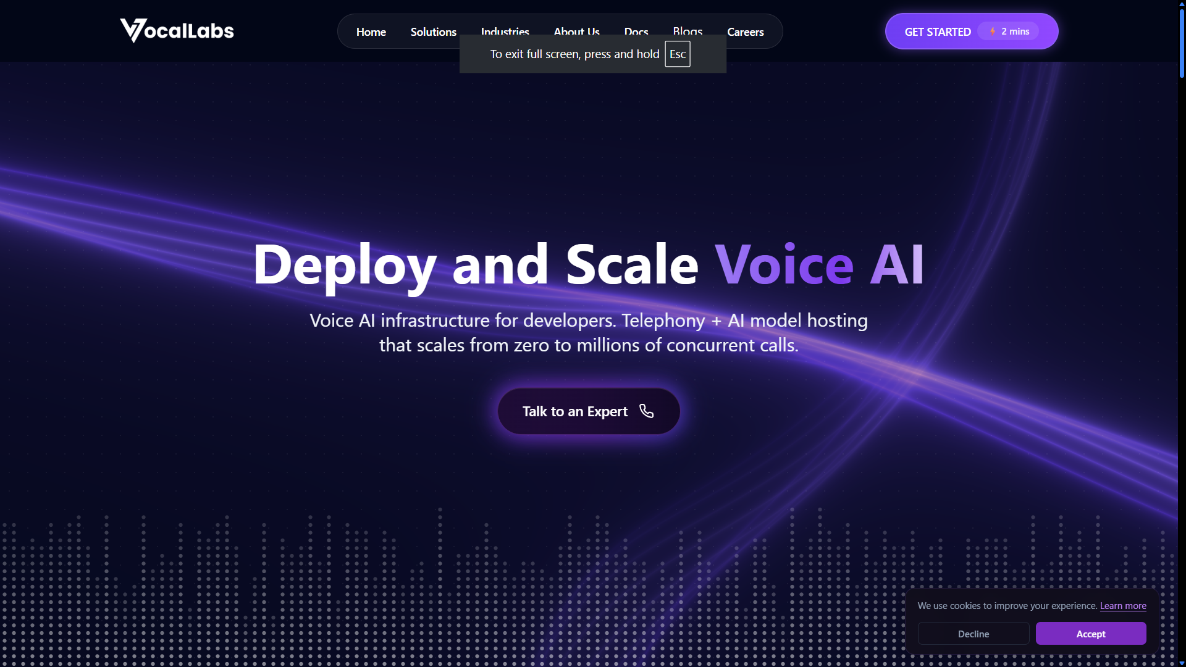
Product Teardown — Vocallabs.ai
Prepared by Sourabh Yadav

Slide 2
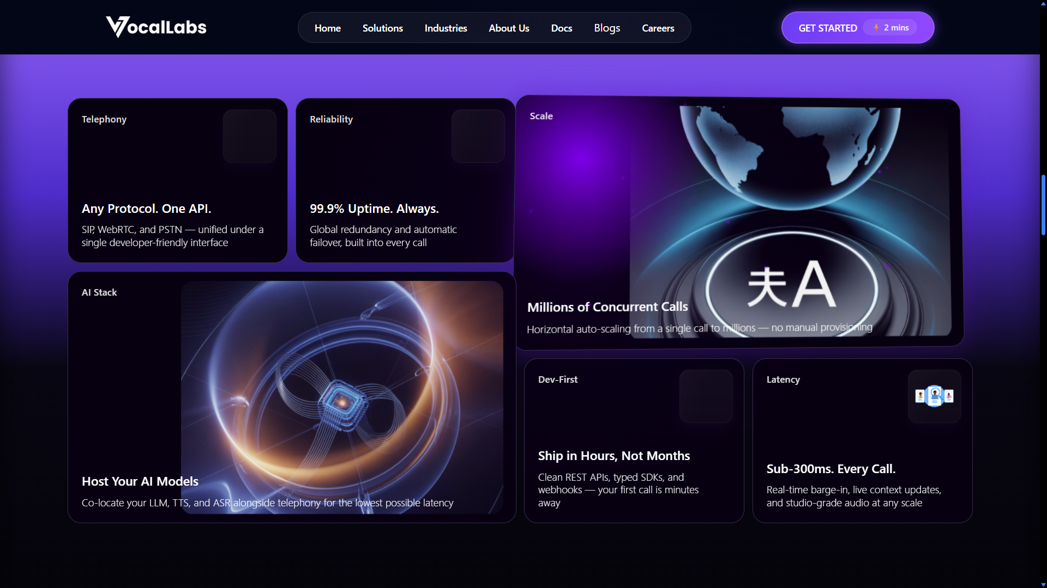
1. GTM & ICP
Observed The homepage heavily emphasizes technical capabilities such as low latency, REST APIs, SDKs, webhooks, and infrastructure scalability.
Problem This positioning works well for developers and technical teams, but non-technical business users may struggle to immediately understand the actual business value.
Ship Instead
• Reduce missed customer calls by 40%
• Automate appointment booking 24×7
• Increase lead qualification efficiency

Slide 3
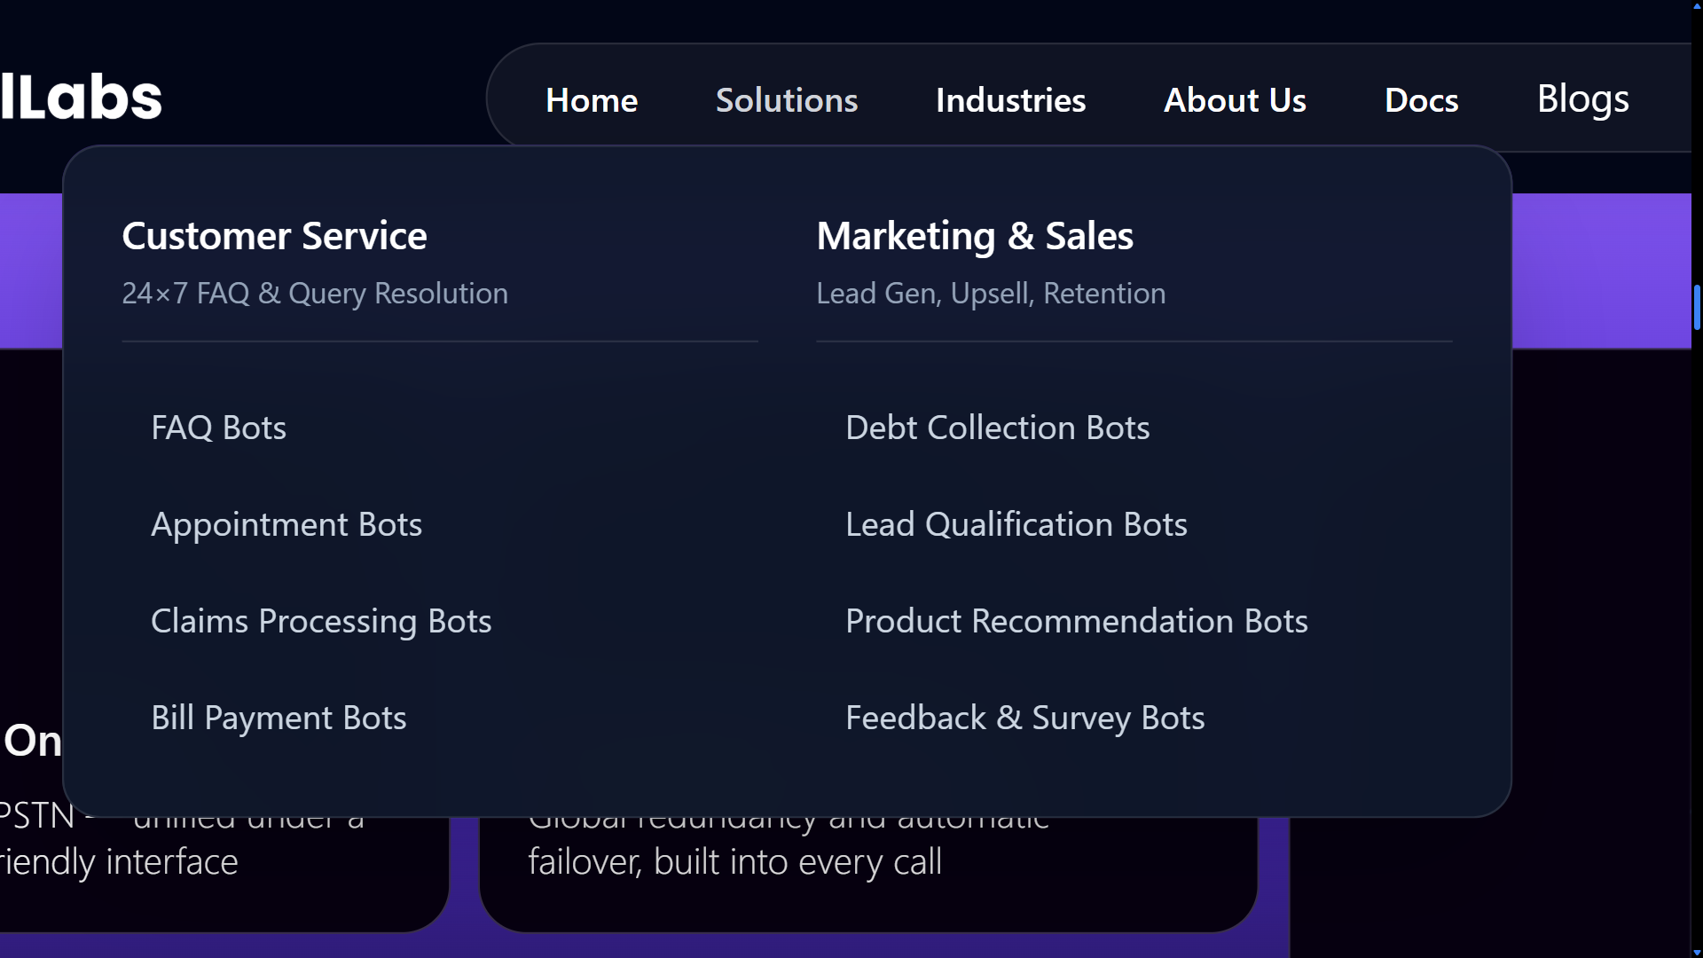
2. UX & Product Discovery
Observed The platform offers multiple AI solutions including FAQ bots, appointment bots, claims processing bots, lead qualification bots, and feedback bots.
Problem New visitors may find it difficult to identify which solution is best suited for their business use case.
Ship Instead
• Interactive onboarding flow
• Industry-specific workflow recommendations
• Tailored demos and integrations

Slide 4
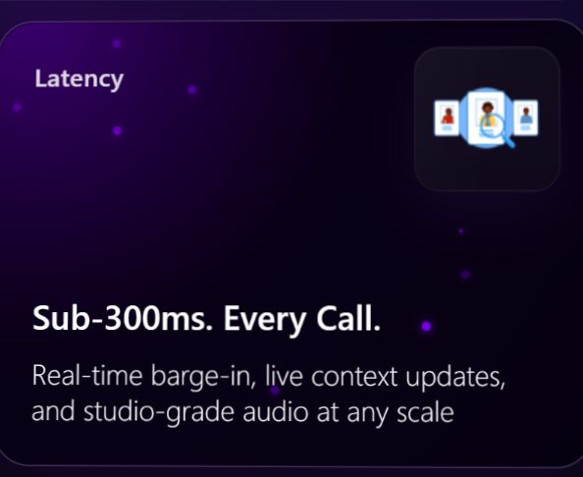
3. Features & Reliability
Observed Vocallabs highlights advanced real-time voice capabilities such as barge-in handling, live context updates, and concurrent calling.
Problem Enterprises may worry about hallucinations, compliance risks, and incorrect responses in sensitive workflows.
Ship Instead
• Confidence-based human escalation
• Compliance logging
• Conversation audit trails
• Sensitive keyword alerts

Slide 5
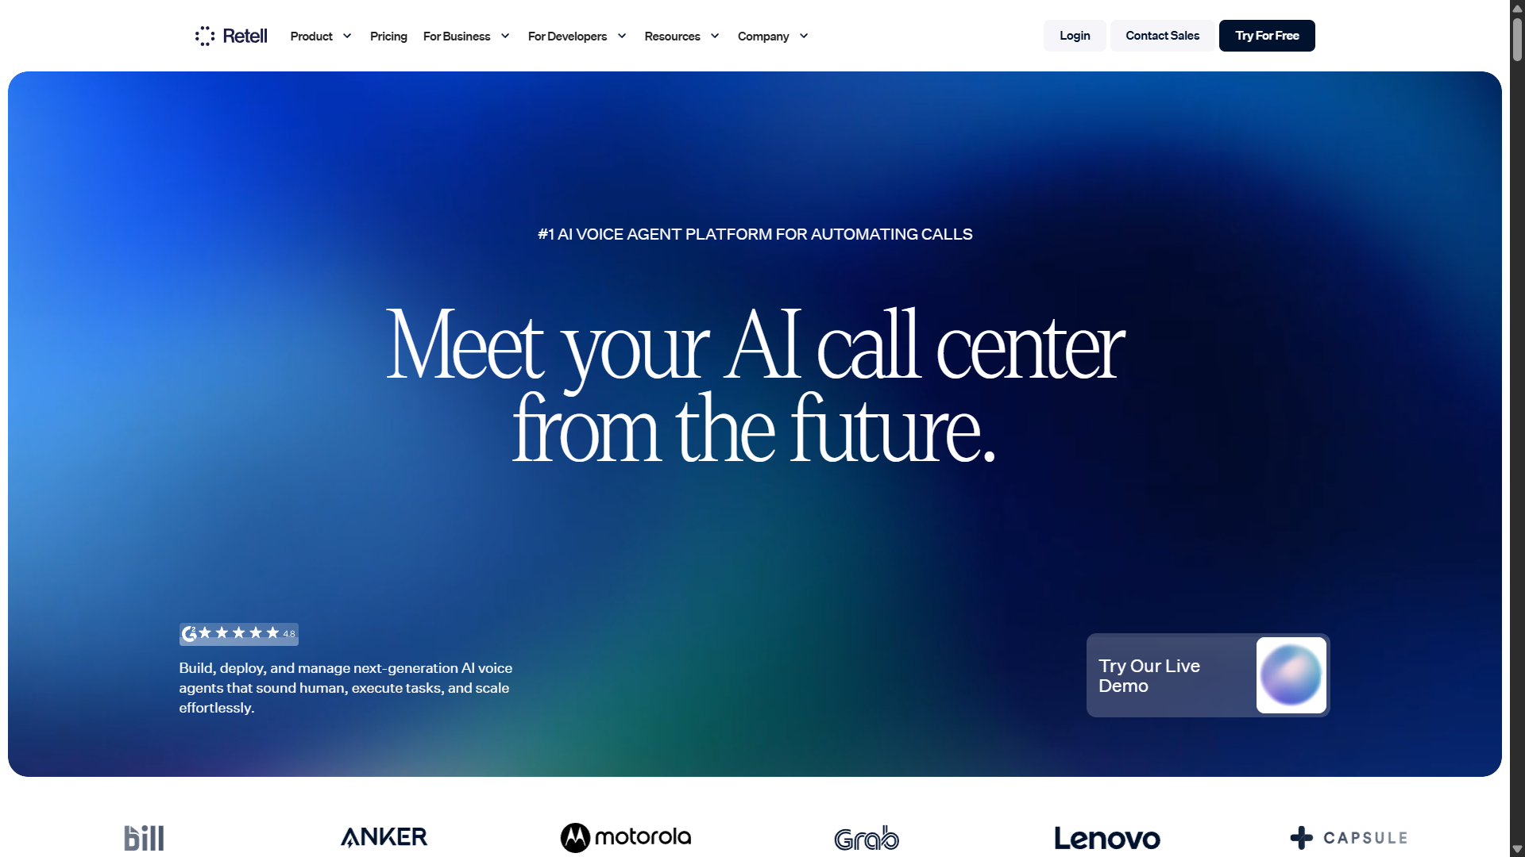
4. Competitor Positioning
Observed Competitors like Retell AI, Vapi, and Bland AI are also positioning themselves as AI voice infrastructure platforms.
Problem Generic AI calling platform positioning may reduce differentiation over time.
Ship Instead
• AI receptionist for clinics
• AI collections agent for fintech
• AI sales qualifier for real estate

Slide 6

5. Product-Led Growth & Activation
Observed The primary CTA across the website is mostly focused on 'Book Demo'.
Problem Many visitors may not want to immediately schedule a sales call, creating onboarding friction.
Ship Instead
• Live AI voice demos
• Interactive sandbox environments
• One-click sample calls
• ROI calculators

